Slide 1
Gratitude:
Look for the Good
Notes:
Gratitude: Look for the Good: (25 minutes)
Background (2-3 minutes)
Negativity bias and Benefits of Positive Emotions (2-3 minutes)
Definition of Gratitude (2 minutes)
Introduce the skill and discussion of gratitude (2-3 minutes)
Look for the Good practice (5-10 minutes)
Discussion of frequency (2-3 minutes)
Review, Questions and Wrap-up: (5 minutes)

Slide 2
How Does Gratitude help?
Builds optimism and positive emotions by paying attention to good things
Helps you cope with daily hassles and stress
Improves social relationships
Notes:
Instructions to Participants:
The goal of this skill is to help people build optimism and positive emotions.
A regular gratitude practice can help you deal with those daily stressors, as well as more significant adversity in your life.
Appreciating things in your life and focusing on the positive can help you adjust and move forward after stressful events.
Researchers have found that expressing gratitude can strengthen social relationships.

Slide 3
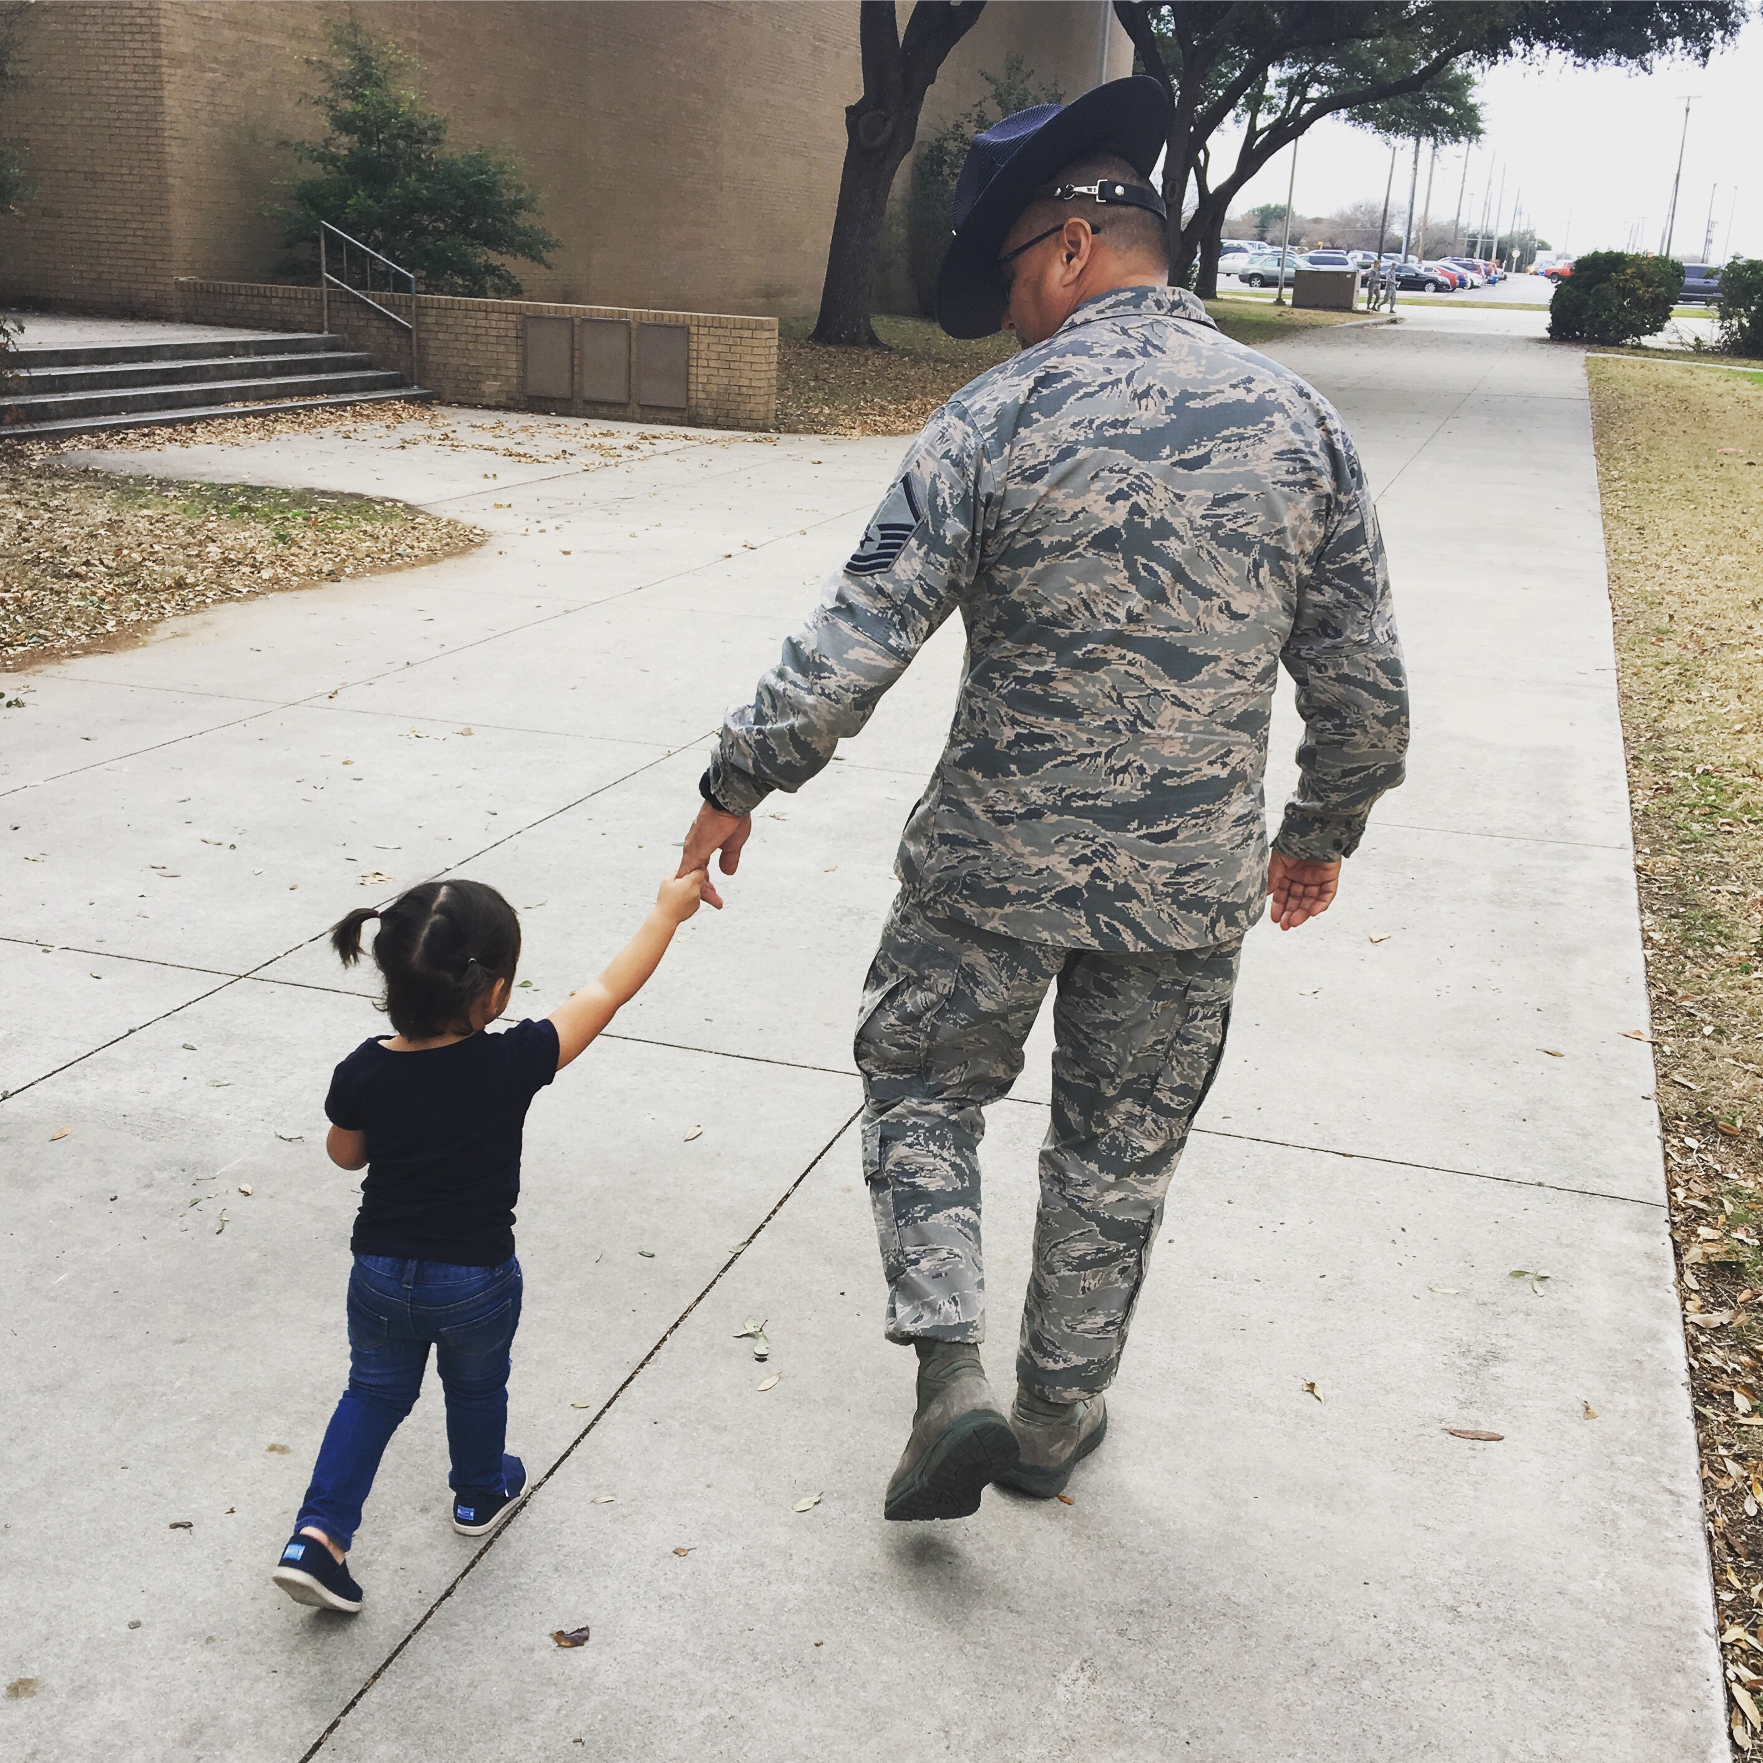
What is Gratitude?
A sense of wonder, thankfulness, and appreciation for life
Looking for the good helps us focus on what went right
Emmons, 2007
Notes:
Instructions to Participants:
Gratitude is a sense of wonder, thankfulness, and appreciation for life.
While we often focus on things that went wrong, cultivating gratitude is a tool that allows you to think about what went right. By actively looking for the good things in our life, we boost positive emotions.
Resilient people don't have fewer negative emotions. Instead, they feel more positive emotions, which allows them to rebound from stress and adversity more easily.

Slide 4
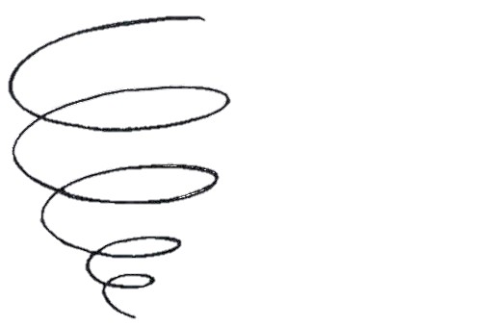
Negativity bias
We are more likely to pay attention and remember negative things than positive things.
Negative emotions trigger:
  Flight
  Fight
  Freeze
Baumeister, 2001; Rozin & Royzman, 2001
Notes:
Instructions to Participants:
We have a natural “negativity bias.”
We are hard-wired to focus on negative events and emotions.
We are more likely to remember negative things than positive things. We process negative information more quickly than positive information.
We work harder to avoid a bad mood than experience a good one
Paying attention to those negative events (and danger) helped us to survive and trigger our fight, flight, or freeze instincts. But, that negativity bias may not serve us as productively any more.

Slide 5
Positive Emotions can help us focus and be more creative
Gratitude and other positive emotions help us:
  Counteract the negativity bias
  Discover and develop new skills
  Improve our performance
Broaden and Build Theory, Fredrickson & Joiner, 2002
Notes:
Instructions to Participants:
Positive emotions are the “fuel” for resilience. They can help us find meaning in our daily experiences, which in turn, builds more positive emotions. Psychologist Barb Fredrickson calls this the “upward spiral.”
Looking for good things helps us counteract our negativity bias.
Experiencing gratitude and other positive emotions make us more likely to discover and develop new skills, and be more creative. Positive emotions help us refocus our attention on good things and helps us perform better.

Slide 6
The Skill: Look for the Good
In the last 24 hours, what is something you are grateful for?
Reflection is key:
  Why did it go well?
  Why is it meaningful?
  How did others contribute to this good thing?
Notes:
Instructions to Participants:
Here’s the skill: Think about something you are grateful for.
Now, think about why it went well or how you or others in your life contributed to the good thing that happened. Those follow-up questions are key. Research shows that the reflection piece helps to make the exercise more meaningful (rather than just writing down a list of three good things, you have to take time to be reflective about them, which elicits more positive emotions).
Stay focused on things that happened in the last 24 hours so you can focus on something recent.

Slide 7
How do you think a gratitude practice builds resilience?
Notes:
Facilitated Discussion:
Look for the Good is a relatively simple skill. So, why do you think a gratitude practice builds resilience?
Possible responses:
Feeling gratitude provides an opportunity for positive emotions, which improves our performance.
It also counteracts our natural negativity bias by helping us focus on something positive.
Reflecting on the cause of the event also helps us think about the assets we have in our life, rather than only focusing on our challenges.

Slide 8
Look for the Good

Slide 9
Activity: Look for the Good
Think about the last 24 hours:
What are you grateful for?
Reflect:
  Why did it go well?
  Why is it meaningful?
  How did others contribute to this good thing?
Notes:
Instructions to Participants:
Now we’d like you to focus on something good that has happened in the last 24 hours and do the same exercise individually. Reflect on what you are grateful for, why it went well, or why it is meaningful, and what others may have contributed?
Then, share with a partner.

Slide 10
Debrief
What was challenging about the activity?
What was helpful?
Notes:
Facilitated Discussion:
What was challenging about thinking of something you are grateful for? Or sharing what you are grateful for?
What did you find helpful?
10

Slide 11
Do I Have to Look for the Good Every day?
Some people benefit more if they reduce the frequency of using the journal
  Not a chore
  Find the right fit for you—daily or weekly
  Do it on a regular basis
Lyubomirsky, 2007
Notes:
Instructions to Participants:
Research has found that some people benefit more from Look for the Good if they reduce the frequency of the activity.
For some people, writing things down everyday day can feel like a chore, rather than something to increase optimism.
Find the right fit for you…but make sure you do it on a regular basis, not just when you feel stress.
When you are first learning the skill, write down what you are grateful for everyday!
After this course:
Continue to Look for the Good, but vary the frequency with which you do it until you get a sense of what works for you.
Find the right fit for you, but try to do it at least once a week.

Slide 12
Skill Review: Gratitude: Look for the Good
Gratitude builds optimism and positive emotions, helps you cope with stress, and improves relationships
  Develop a regular (daily or weekly) gratitude practice that:
    Includes 1-3 things that you are are grateful for
    Includes a reflection on why you are grateful

Slide 13
